Slide 1
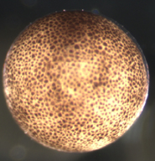
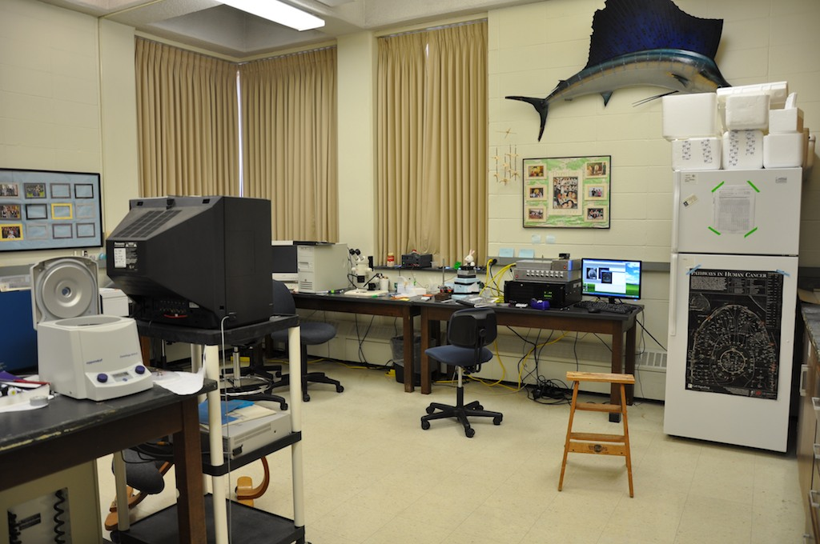
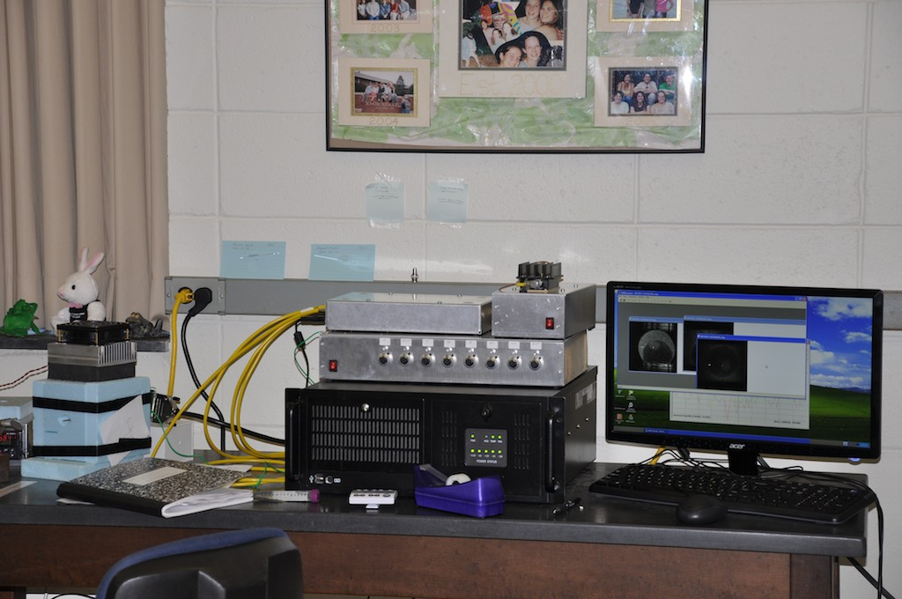
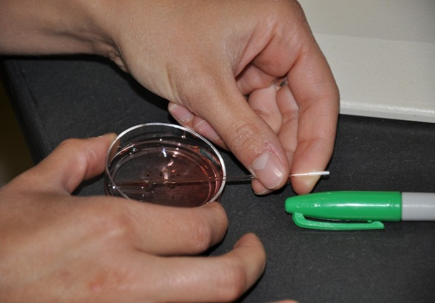
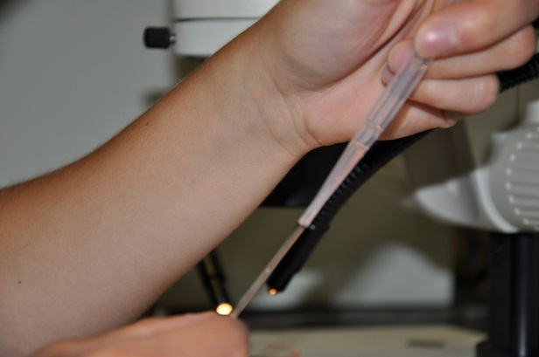
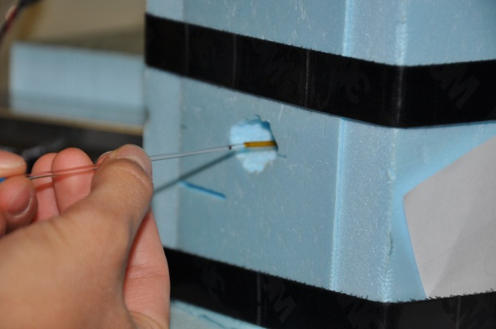
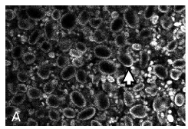
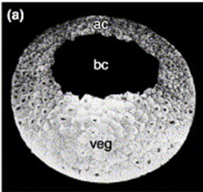
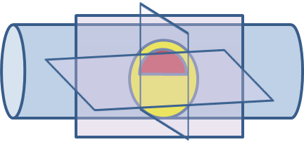
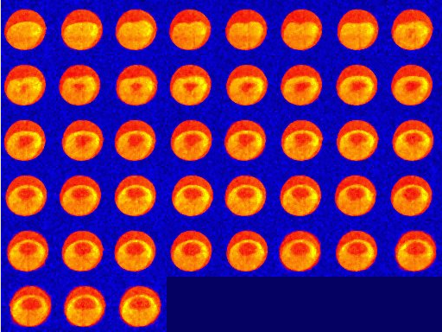
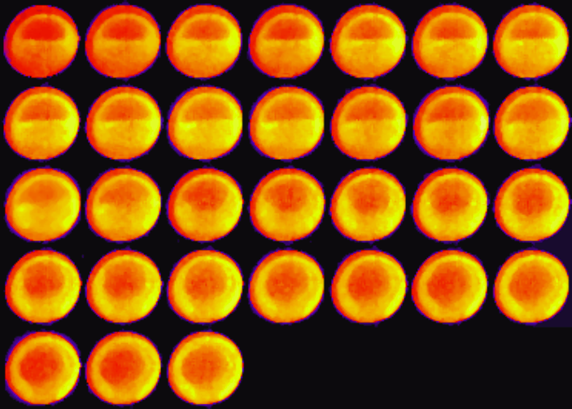

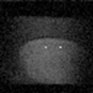
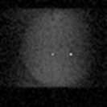
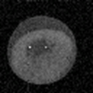
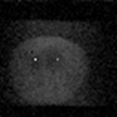
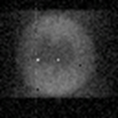

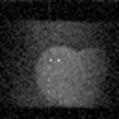

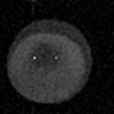
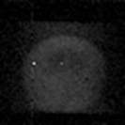
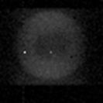
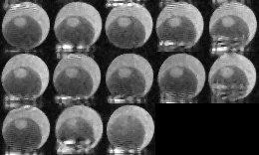
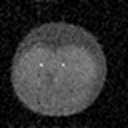
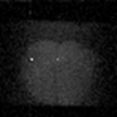
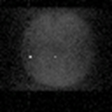
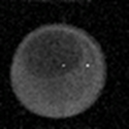
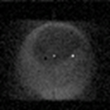
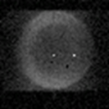
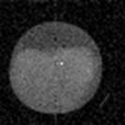
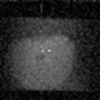
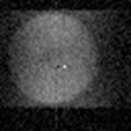
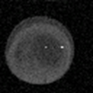
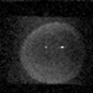
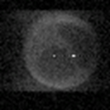
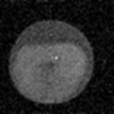
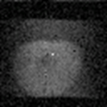
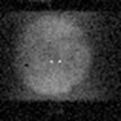
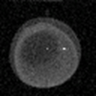
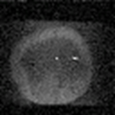
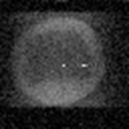
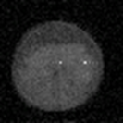
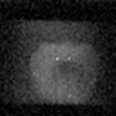
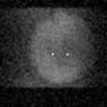
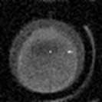
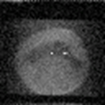
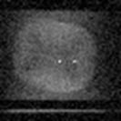
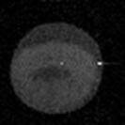
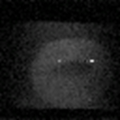
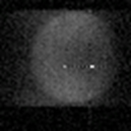
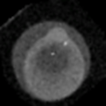
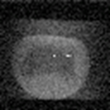

Ultra Compact MRI: A new realistic tool for Xenopus research
Andrew F. McDowell, ABQMR, Inc. Albuquerque, NM, USA
Rebecca Hartley, Therese Mitchell, University of New Mexico SOM, USA
Judith M. Thorn, Kelli Huber, Knox College, Galesburg, IL, USA
The Problem:
Imaging the interior of a live Xenopus embryo is difficult
Our Solution:
Utilize miniaturization techniques & expertise to aggressively optimize MRI as a tool for Xenopus research
  Modest cost
  Easy to use
  Useful
Knox College Installation
Site is ~ 1600 km from R&D lab (ABQMR)
Typical American liberal arts college (1400 students, no graduate programs)
Strong tradition of undergraduate research
Device was installed by instrument developer in a standard developmental biology lab
Basic training provided in MRI theory and instrument use
One follow-up visit to improve device performance, otherwise device has been operated by the biologists
Instrument in operation at Knox since early June 2012
The non-MRI experts at Knox have produced our best images!
Confocal Microscopy
Near-surface
$$$$
(Larabell, et al, 1996)
Histology
Not-live
Typical Experimental Protocol
Embryo (or oocyte) selected
Sample tube over-filled with growth media
Embryo dropped into tube using large-bore syringe
Embryo falls down into the tube
Tube sealed with parafilm (or clay)
Tube inserted into magnet
“Scout” images used to position embryo
Research image type and parameters selected
Data acquisition started
Aside from the sample tube, nothing new for a typical lab.
Traditional MRI
$$$$$$$
(Papan, et al. 2007)
The device in a typical lab space (Knox College).
Practical features of the UC-MRI
Magnet: 15 cm x 15 cm x 28 cm
Sample size: 1.5 mm diameter
Required space: 1.5 m of bench top
Anticipated user: Developmental Biologist
(with limited technical MRI knowledge)
Maintenance: ~ none
Idle equipment cost: ~0
Capital cost: < 50,000 USD (est)
1
7
2
8
A B C D E
F G H I J
K L M
3
11 ½
4
13
5
15
Germinal Vesicle Breakdown
The maturation of a single oocyte in vivo after the addition of 2mM progesterone. Hours post progesterone: (A) 1 hr (B) 2 hrs (C) 3 hrs (D) 4 hrs (E) 5 hrs (F) 6 hrs (G) 7 hrs (H) 8 hrs (I) 9 hrs (J) 10 hours (K) (L) 11 hrs (M) 13.25 hrs. Images are heavily T2-weighted and show significant imaging artifacts.
6
17
6 ½
20
Staging by MRI
Nieuwkoop & Faber stage determined by visual inspection, then quickly insertion into the UC-MRI for imaging. Images slices in the three orthogonal directions. 2D slice selective spin-echo images. 64x64 pixels. Resolution: 32 µm in-plane, 200 µm thick slice. Temperature: 16 °C. No image processing. Repetition time 1.2s, echo time 10 ms, 16 averages. Time for each image: 1.28 minute
Early development in the UC-MRI
Imaged every 20.5 minutes beginning at the one-cell stage. 2D slice selective spin-echo images. 64x64 pixels. Resolution: 32 µm in-plane, 200 µm thick slice. Temperature: 16 °C. Images processed in ImageJ. Repetition time 1.2s, echo time 10 ms, 16 averages. Total elapsed time: 14.33 hours.
An embryo gastrulating in the UC-MRI
Imaged every 20.5 minutes starting midblastula. 2D slice selective spin-echo images. 64x64 pixels. Resolution: 32 µm in-plane, 500 µm thick slice. Temperature: 16 °C. Images processed in ImageJ. Repetition time 1.2s, echo time 10 ms, 16 averages. Total elapsed time: 10.25 hours.
We are looking for collaborators!
Continued technical and funding development require using the device to achieve biological research goals.
Although the device does not provide optical resolution, it has unique advantages that may allow new experiments.
Do you have ideas for how this device might be helpful?
Would you like to try these ideas in your own research lab?
Contact: Andrew McDowell
mcdowell@abqmr.com
More Device Details .
Magnet: Dipole (North-South pole) design Experiments: T₁ & T₂ weighting
1.7 T SmCo Spin Echo and Gradient Echo
5 mm gap between poles 2D slice selective imaging
1st & 2nd order field shim coils 3D phase encoded imaging
< 1 ppm field uniformity Resolution: 32-64 µm (present limits)
Temperature: 0.1 °C stability 200-5000 µm thick slice
Has been operated at 14-34 °C (user selectable)
~ 1 day to fully equilibrate Automation: Repeated time course
< 20 W total power required Image reconstruction and display
Data can be exported to ImageJ for further processing & analysis
How can this be possible?
The tiny magnet is still more powerful than typical human MRI.
Miniaturization improves the MRI signal-to-noise ratio for small samples
Operation at 16°C slows growth, allowing more time to build up signal-to-noise
Consistent physical size and NMR properties among embryos allow great simplification in user controls
Size matters:
  Smaller → magnet is cheaper
  Smaller → better match to sample
  Smaller → easier to integrate into lab
This project is supported by Grant Number 1R43RR032603-01 from the National Center for Research Resources of the National Institutes of Health. Its contents are solely the responsibility of the authors and do not necessarily represent the official views of the NIH.

